Slide 1
Neurophysiology Using Crickets
Ben Latimer – Neural Engineering Laboratory – University of Missouri

Slide 2
Experiment 1: Pharmacological manipulations of neuronal activity using the cricket cerci
In this experiment, students study the role of ions and ionotropic receptors in the regulation of action potentials.
Extracellular recordings are made in the cerci ganglion which have a relatively high spontaneous tonic firing rate.
When nicotine is injected, it binds to the nicotinic Acetylcholine Receptor allowing for an increase in conductance at the neuromuscular junction which manifests larger firing frequency in the recordings.
This activity is adapted from Dagda, R. K., Thalhauser, R. M., Dagda, R., Marzullo, T. C., & Gage, G. J. (2013). Using crickets to introduce neurophysiology to early undergraduate students. Journal of Undergraduate Neuroscience Education : JUNE : A Publication of FUN, Faculty for Undergraduate Neuroscience, 12(1), A66-74.

Slide 3
What you need
Backyard Brains one or two-channel Spikerbox
Large Crickets (available at any pet store as reptile food)
Ice
Nicotine (cut open a cigarette and let the tobacco soak in water for a couple of days)
1 cc syringe to inject nicotine
Computer with Audacity and SIGVIEW or SpikeHound installed

Slide 4
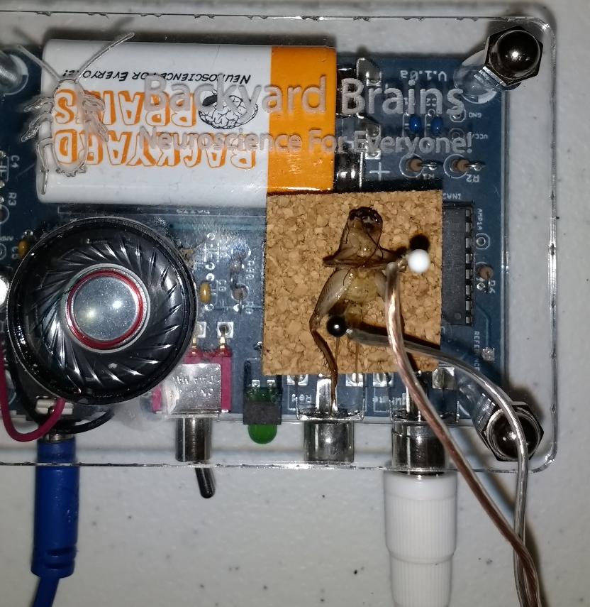
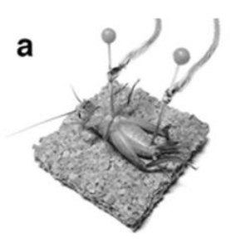
Procedure
Put a cricket on ice for 5-10 minutes until it has stopped moving
Place the cricket on the corkboard on top of your Spikerbox
Pierce the cerci ganglion (right between the hind legs) with the electrode that is not ground and place the ground electrode in the abdomen as shown here

Slide 5

Procedure
You will need to zoom in using the microscope tool in audacity to view the activity. If the cricket is still cold, you won’t see activity but after it warms up a bit it should look something like this:

Slide 6
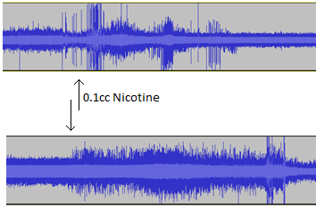
Procedure
Inject 0.1 cc of your nicotine solution into the cricket’s abdomen and mark down the time. If you have a good connection, you will see the firing rate increase dramatically after the nicotine is injected.

Slide 7
Results
You can quantify these results using SIGVIEW or SpikeHound (the latter is free online) to measure the frequency of spikes. Alternatively, you can generate your own custom MATLAB code.
Students can plot the increase in frequency and measure across several specimens to get an average.

Slide 8
Experiment 2: Demonstrating the principles of rate coding
Crickets have cerci on their legs that are some of the most sensitive mechanoreceptors in nature. They evolved these receptors to evade predators by sensing changes in wind direction.
We can use the same setup as in the previous experiment to measure the responsiveness of the neurons to varying degrees of stimulation.

Slide 9
What you need
Everything from the previous experiment except the nicotine.
Again, put the crickets on ice to anesthetize them and set up the cerci ganglion preparation as shown on slide 4.

Slide 10
Procedure
You can use a toothpick or wind to stimulate the cerci.
I suggest using wind because it’s easier to vary the degree of stimulation.
If you have compressed air available, you can use that. Otherwise, students can lightly blow on the cricket’s legs. In audacity, you should see the following in response to blowing on the legs.

Slide 11
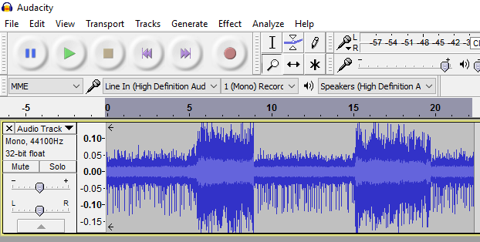
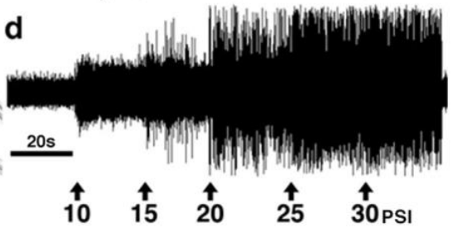
Results
Blowing on the cerci increases the firing frequency. You can have students vary the strength with which they apply the breath to see the rate coding that the ganglion use to produce behavior.
Dagda et al. 2013

Slide 12
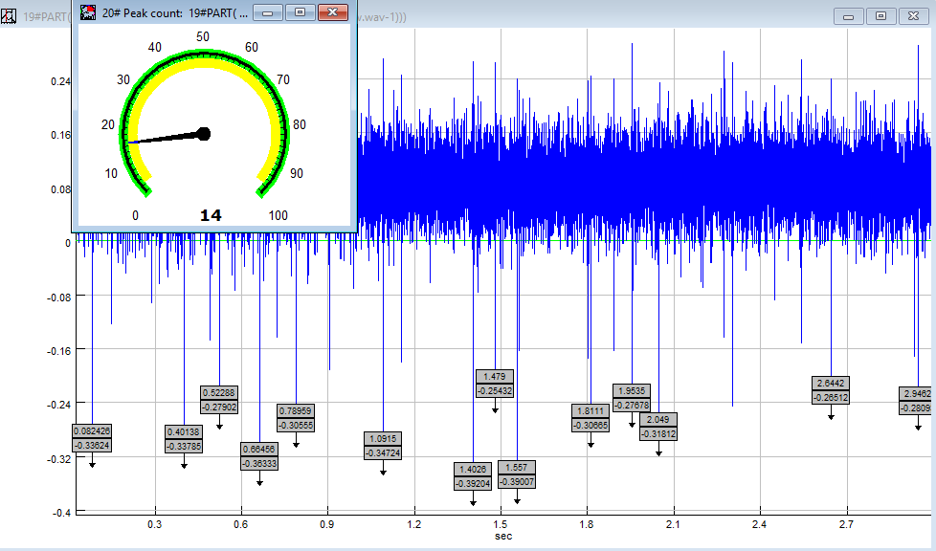
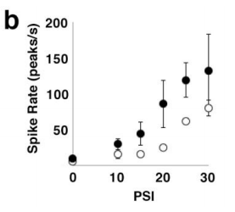
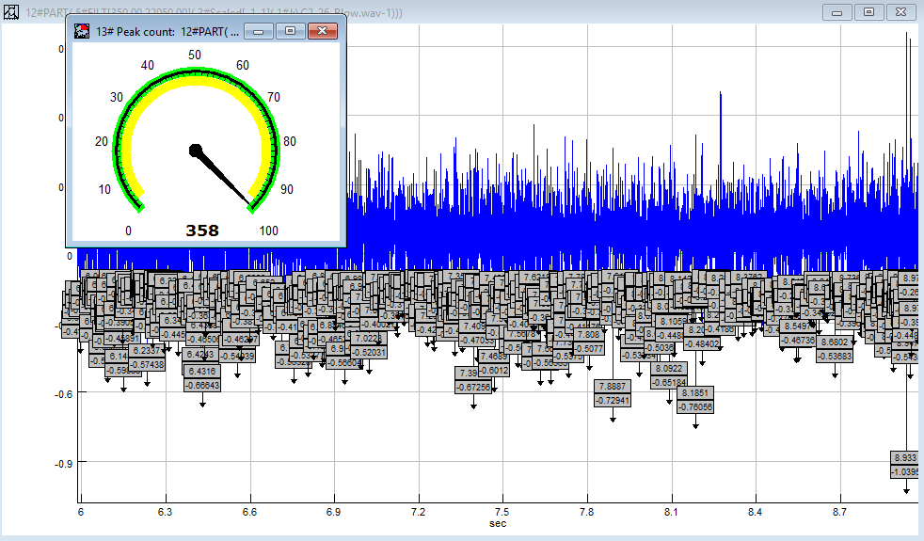
Results
The figures on the right show using SIGVIEW to quantify the firing rate. The two rates are for a 3 second measurement, corresponding to ~5 Hz and 119 Hz respectively.
Dagda et al. 2013

